Slide 1
Welcome!
This is your customizable presentation that you can use to share Lightning Experience with your company, gain executive buy-in, and educate stakeholders on Lightning Experience. Feel free to make changes to support your use cases.
If you’re an existing customer, you can also use this to decide when to start migrating all or part of your team to Lightning Experience.

Slide 2
Lightning Experience Overview
your
logo
here
Meet the new Salesforce!
First Name Last Name
Title of Presenter

Slide 3
Objectives
What you can expect from this presentation
Introduction to Lightning Experience
Understanding the user experience
Resources
Where to learn more
How existing customizations are impacted
How to roll out Lightning Experience

Slide 4
Introduction to Lightning Experience

Slide 5
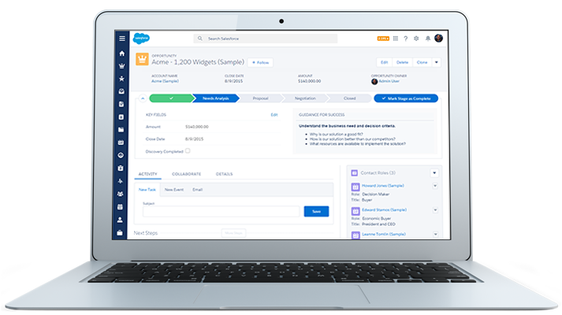
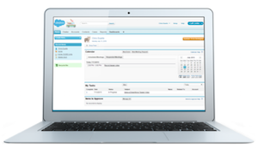
Meet the new Salesforce!
Sell smarter, faster, and the way you want
Lightning Experience | Salesforce Classic
Learn about Lightning Experience | Understand the previous experience

Slide 6

Introducing Lightning Experience Features
A set of 25+ powerful features to support your business
App Launcher
Sales Path
Home
Composer
Quick View
Assistant
Contact Insights
Board View
lightning experience
Highlights Panel
Performance Chart
Alerts
Master-Detail View
Filters
User Profile
Account Insights
Workspace
Notifications
List View Chart
Navigation Menu
Email Composer

Slide 7
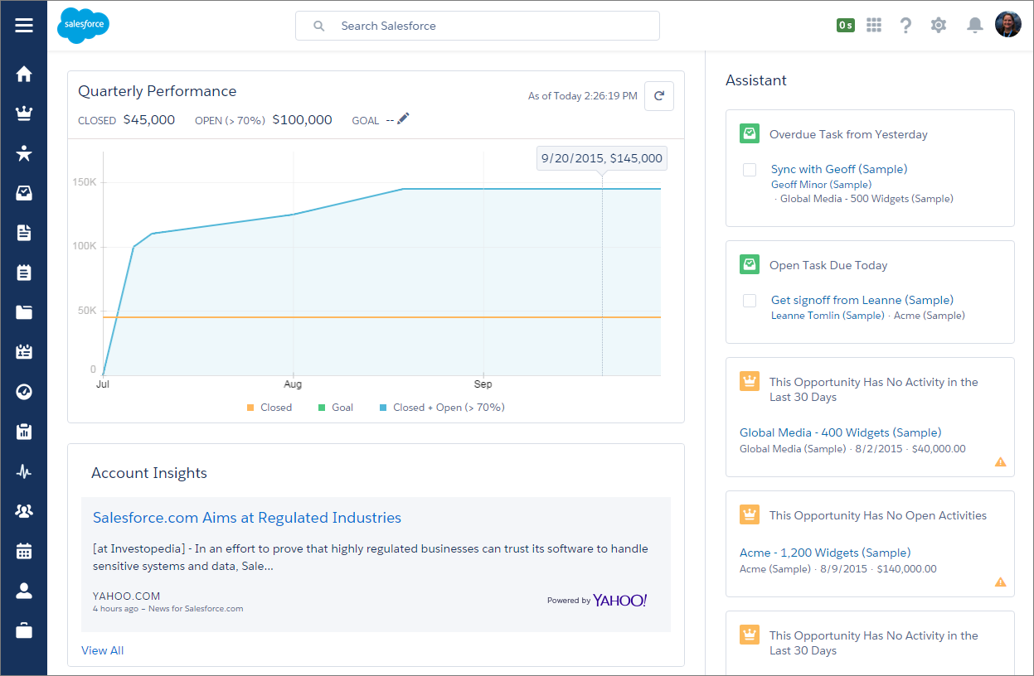
Home
An intelligent way to start your day fast
Performance Chart
Track your performance to target
Assistant
Helps you focus on what matters most with proactive notifications
Account Insights
Personal and relevant new articles about top accounts that help you take meaningful action

Slide 8
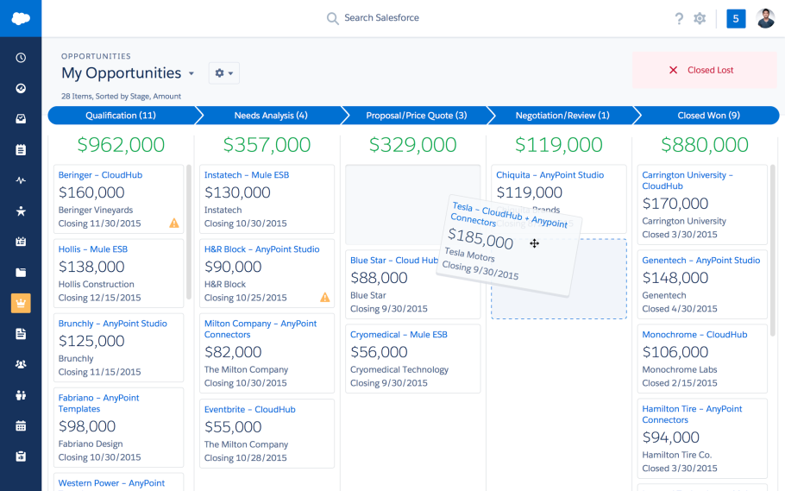
Board
A powerful way to visualize and work your pipeline
Visualize Your Pipeline
See your opportunities organized by stage, with subtotals up top
Drag and Drop
Move deals between stages with click and drag
Alerts
Get intelligent alerts prompting you to take action on deals that need your attention

Slide 9
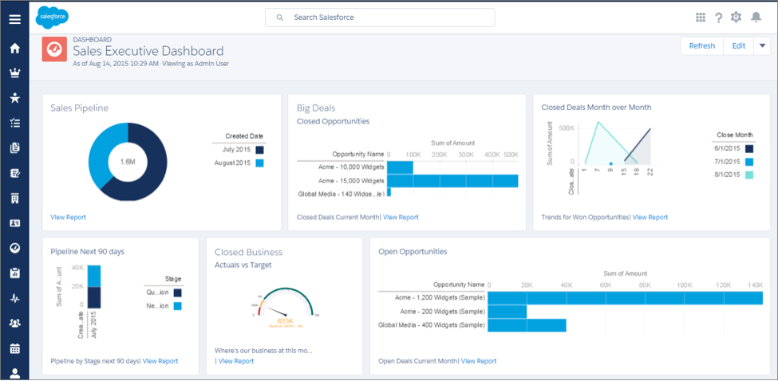
Dashboards
Visualize your data with beautiful charts and a flexible layout
Spanning columns
Give a chart the space it needs to show the right data
Flexible Layout
Add more components in a row with more columns available
Easy Filters
Add filters with a simple, visual interface

Slide 10
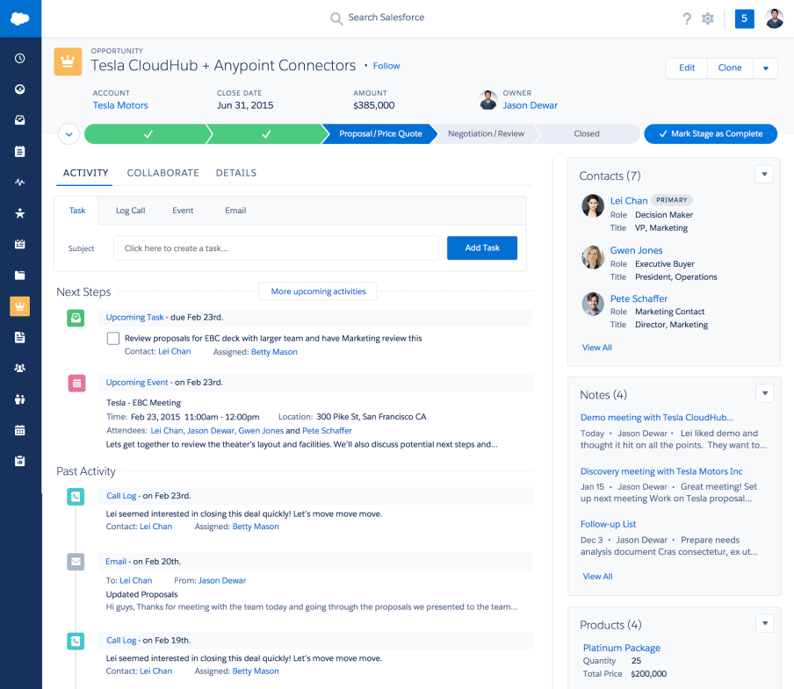
Opportunity & Lead Workspaces
Action-oriented workspaces to work your deals in flight
Sales Path
Customizable guidance to support your sales process
Timeline
Easily view open and previous activities and create records on the fly
Quick View
Hover over links to view details without ever leaving the page
Highlights Panel
See important information at a glance

Slide 11
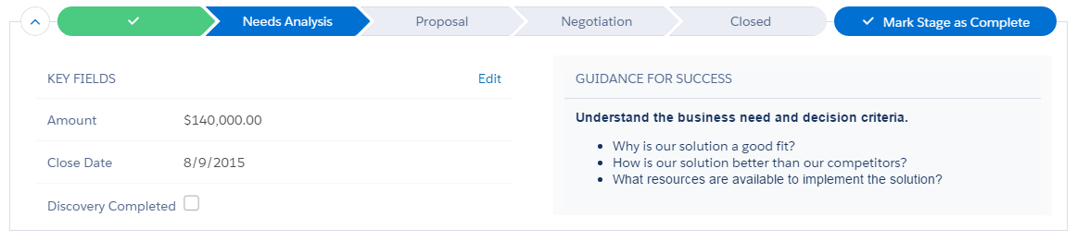
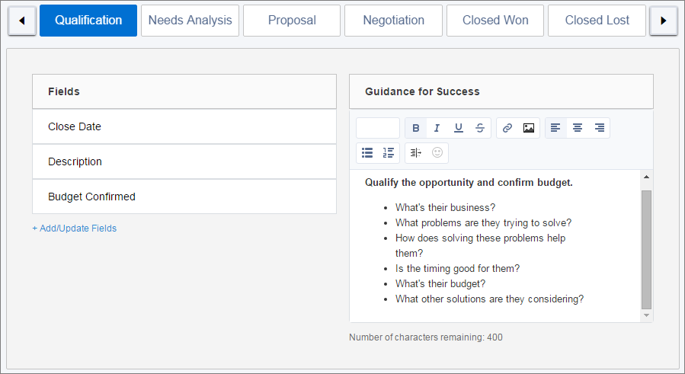
Sales Path
Helpful guidance and relevant information at every stage to support your sales process
Customizable
Add your statuses and stages for leads and opportunities
Guidance for Success
Provide coaching in context at each step in the sales process, including helpful scripts, questions to ask, and tips
Key Fields
Present important details up top, with the ability to edit
Customize Sales Path to support your sales process

Slide 12
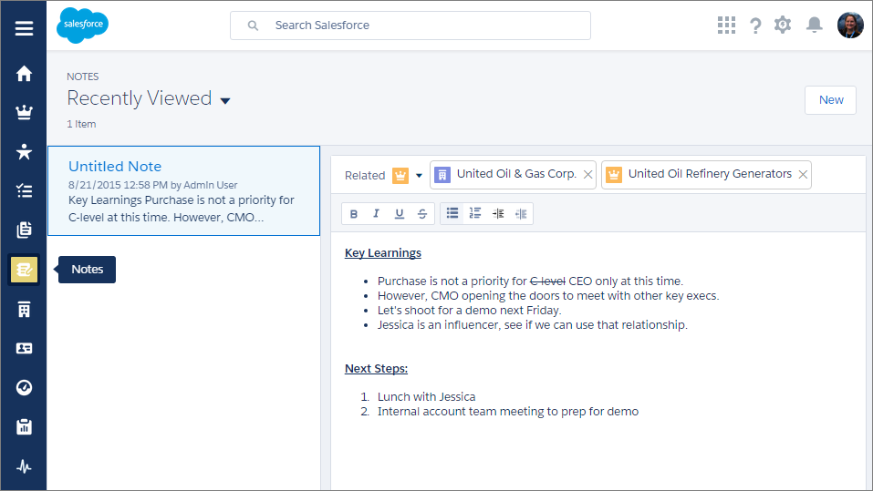
Notes
Take detailed notes and relate them to multiple records
Relate to Multiple Records
Relate a single note to an account, contact, opportunity, and more
Autosave
Never lose a detail while you compose your thoughts
Rich Text
Add bullets, numbered lists, or text formatting to organize your content for easy reference

Slide 13
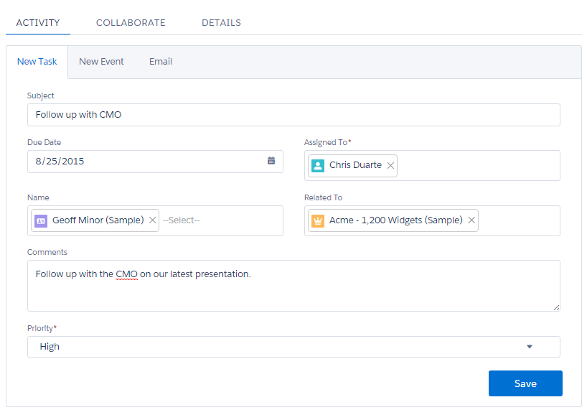
Composer
Take action fast on any record, customized for your needs
New Task
Make a follow-up task
New Event
Make a meeting request
Email
Compose an email with rich text formatting, attachments, templates, and more
Collaborate & Details
Click Collaborate and Details tabs to access Chatter and see all fields, respectively

Slide 14
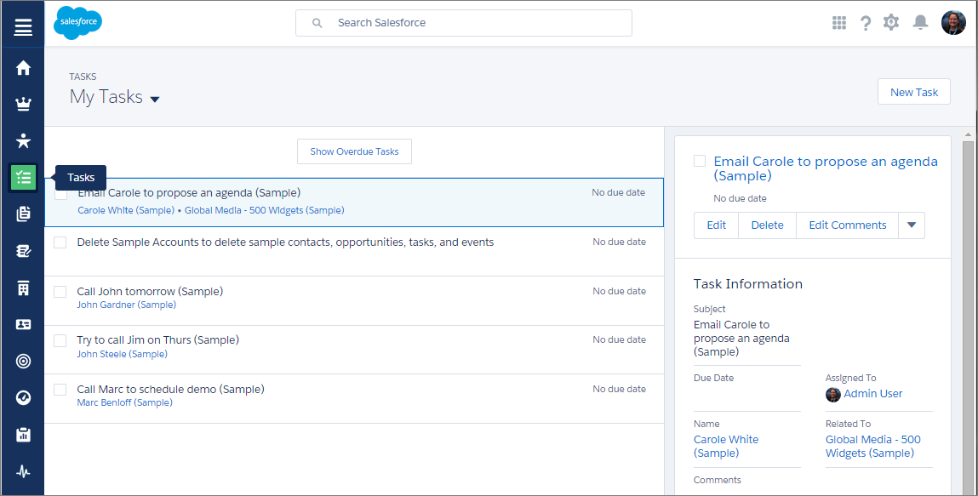
Tasks
View and update all your tasks from one place
Tasks
Access your tasks from a convenient Tasks page right from the navigation menu
Master-Detail
See your complete task list, and drill into any task, side-by-side
Actions
Edit a task, add comments, and change priority, status, and more

Slide 15
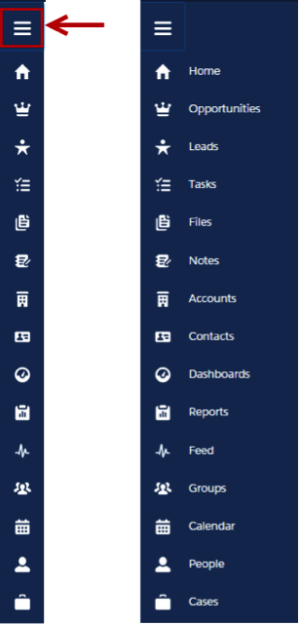
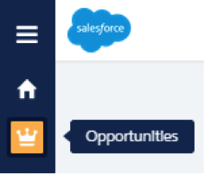
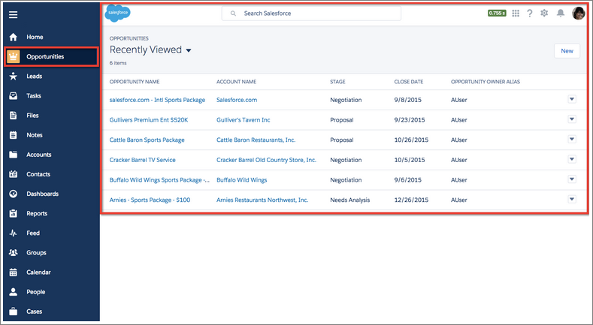
Navigation Menu
Navigate your way through the app with collapsible menu
Collapsible
Space-saving navigation menu can be expanded as needed
Hover
Hover over any icon to see the name of the object
Access
Drill into any object to access records, or launch the App Launcher to access other objects

Slide 16
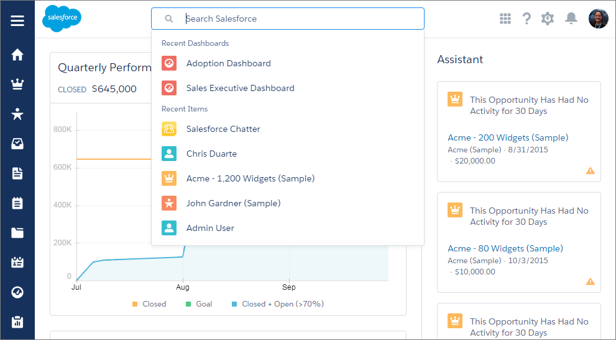
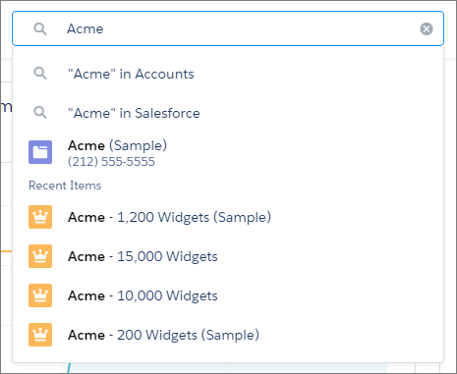
Search
Find what you’re looking for fast
Recent Items
Drop-down list of your recently-viewed items
Type-Ahead Search
Potential matches for your search suggested as you type
Frequently-Used Objects
Search results show your most frequently used objects and top results at the top

Slide 17
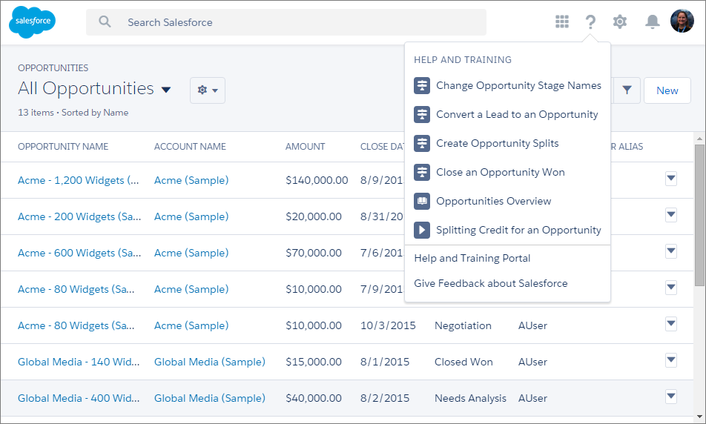
Help Menu
Get contextual help right in Salesforce
Contextual Help
Find contextual help topics, videos, guides, and more, all in the context of the page you’re viewing
Walkthroughs
Get an in-app walkthrough on the topic you choose by clicking a walkthrough link
Feedback
Give instant feedback on Salesforce and Lightning Experience

Slide 18
Understanding the user experience

Slide 19
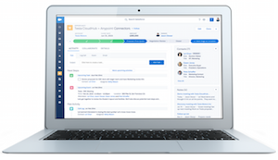
Lightning Experience and Salesforce Classic
Both experiences are available for customers to use, at the org level, profile level, or user level
Lightning Experience | Salesforce Classic
The user experience immediately predating Lightning Experience is Salesforce Classic.
Features not yet supported in Lightning Experience are available in Salesforce Classic.
If you’re not ready to migrate all users to Lightning Experience, you can use both Lightning Experience and Salesforce Classic.

Slide 20
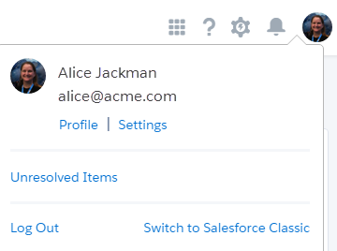
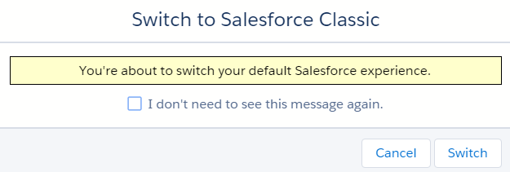
Switching Between Interfaces
You can switch between Lightning Experience and Salesforce Classic with ease
Any user can switch between interfaces on demand

Slide 21
Understanding your options
Roll out to all users or pilot with a group of users
1
2
3
Pilot Group of Users
New Users
All Users
If you’re just starting with Salesforce,
start with
Lightning Experience
Use Permission Sets or Profiles to
run a pilot of
Lightning Experience
Migrate your entire user population
at one time to
Lightning Experience

Slide 22
Resources

Slide 23
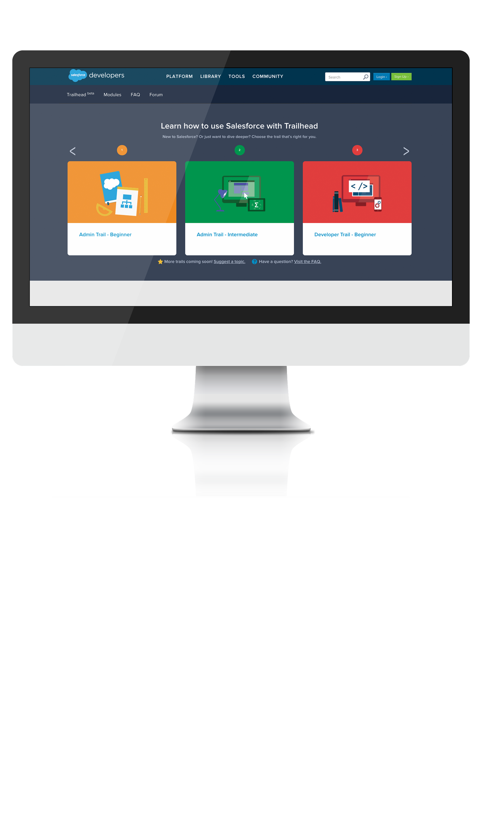

Introducing Trailhead
Your free guide to learning and challenging yourself on the Salesforce1 Platform.
trailhead.salesforce.com

Slide 24

How Existing Customizations are Affected
How to assess if any existing customizations are affected by Lightning Experience
Get the Lightning Experience Basics badge on Trailhead, where you’ll learn how to:
Conduct a gap analysis
Compare the two user experiences
Learn about what isn’t supported
See Appendix A for additional details

Slide 25

How to roll out Lightning Experience
Develop a rollout strategy and go live with greatness
Get the Lightning Experience Rollout badge on Trailhead, where you’ll learn how to:
Get educated on Lightning Experience
Craft and execute a rollout plan
Measure your results

Slide 26

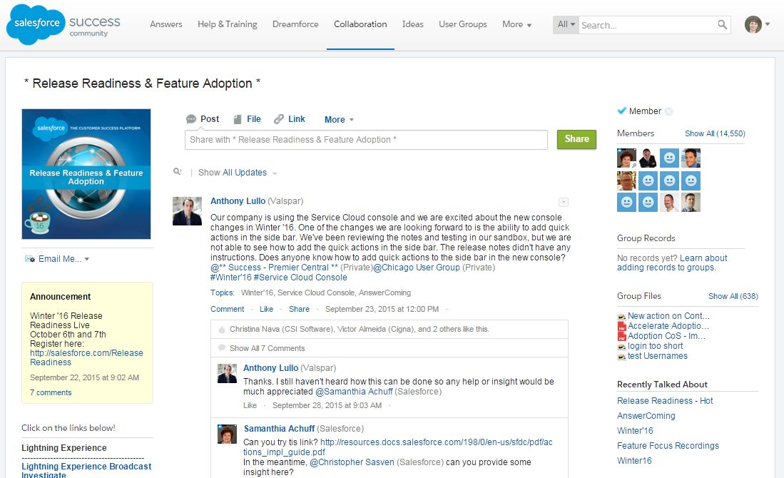

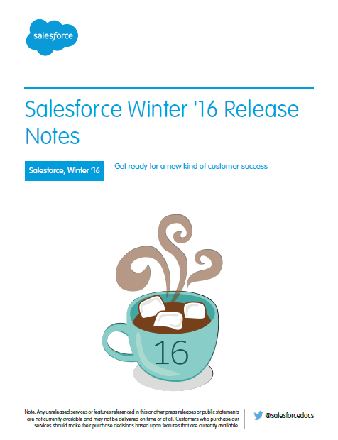
Learn and Engage
Where to learn more about Lightning Experience
Get your badges on Trailhead
Read the Release Notes
Watch the Video Series
Join the Release Readiness & Feature Adoption group (access key resources in the left navigation menu)
Learn
Engage

Slide 27
THANK YOU

Slide 28
Appendix A: Comparison Charts

Slide 29
Comparison Chart: Home
This isn’t a comprehensive list of supported and unsupported features. For a more detailed list, please see the Salesforce Help.
Feature | Lightning Experience | Salesforce Classic
Performance Chart | X
Assistant | X
Account Insights | X
Chatter |  | X
Customizable dashboards |  | X
Tasks | X | X
Items to Approve |  | X
Calendar |  | X
Recent Records | X | X
Top Deals | X
Customizable home page components |  | X

Slide 30
Comparison Chart: Accounts & Contacts
This isn’t a comprehensive list of supported and unsupported features. For a more detailed list, please see the Salesforce Help.
Feature | Lightning Experience | Salesforce Classic
Account Insights | X
Contact Insights (Closed Pilot in Winter ’16) | X
Highlights panel | X
Activity Timeline | X
Distinct ‘reference’ page layout | X
Related lists | X | X
Notes component | X | X
New Files | X
Twitter highlights | X | X
Quick View (hover) | X
Granular sharing and security settings | X | X
Collaborate | X | X
Person Accounts |  | X
Account Teams |  | X

Slide 31
Comparison Chart: Leads & Opportunities
This isn’t a comprehensive list of supported and unsupported features. For a more detailed list, please see the Salesforce Help.
Opportunities
Feature | Lightning Experience | Salesforce Classic
Opportunity Teams |  | X
Opportunity Splits |  | X
Add similar opportunities |  | X
Big deal alerts |  | X
Leads & Opportunities
Feature | Lightning Experience | Salesforce Classic
Customizable highlights panel | X
Sales path | X
Create related records in context | X
Quick view (hover) | X
Composer | X | X*
Integrated email and templates | X | X
Workspace template page layout | X
Activity timeline | X
Enhanced Notes | X
New Files | X
Collaborate | X | X
Leads
Feature | Lightning Experience | Salesforce Classic
Find duplicate leads |  | X
Change lead owner to a queue |  | X
Lead campaign history |  | X
Create leads | X | X
Assign leads to campaigns |  | X
Customize lead conversions via API | X | X
*Similar capabilities available in Salesforce Classic with actions in the publisher.

Slide 32
Comparison Chart: Board
This isn’t a comprehensive list of supported and unsupported features. For a more detailed list, please see the Salesforce Help.
Feature | Lightning Experience | Salesforce Classic
Charts | X
Create filters on the fly | X
Drag and drop | X
Intelligent Alerts | X
Type-ahead list view search | X
Advanced Filter Logic ((1 and 2) or 3)
Sortable columns
Sharing settings | X*
Create and edit list views | X
* Only list views marked as “Visible only to me” or “Visible to all users” are supported. Sharing with certain groups of users isn’t supported.

Slide 33
Comparison Chart: Reports
This isn’t a comprehensive list of supported and unsupported features. For a more detailed list, please see the Salesforce Help.
Feature | Lightning Experience | Salesforce Classic
Create filters | X
Enhanced report charts | X
Matrix report details auto-hidden | X
Hide totals and subgroups from report view page | X
Scheduling reports |  | X
Follow reports |  | X
Report folder sharing | X* | X
Create report folders |  | X
Report notifications |  | X
Bucket fields | X | X
Custom summary formulas | X | X
Joined reports |  | X
Report editing | X | X
* You can’t set up folder sharing in Lightning Experience; however, folders viewed in Lightning Experience that were created in Salesforce Classic inherit all permissions assigned in Salesforce Classic.

Slide 34
Comparison Chart: Dashboards
This isn’t a comprehensive list of supported and unsupported features. For a more detailed list, please see the Salesforce Help.
Feature | Lightning Experience | Salesforce Classic
More than 3 columns supported | X
Flexible layout | X
Schedule dashboard refresh | X* | X
Follow dashboards |  | X
Dashboard filters |  | X
Enhanced dashboard list views | X
Some visualization components |  | X
* Dashboards that are already scheduled in Salesforce Classic will run as scheduled.

Slide 35
Comparison Chart: General
This isn’t a comprehensive list of supported and unsupported features. For a more detailed list, please see the Salesforce Help.
Feature/Product | Lightning Experience | Salesforce Classic
Custom objects | X | X
Quotes |  | X
Forecasting |  | X
Territory management |  | X
Campaigns |  | X
Inline editing |  | X
Salesforce Communities and Partner Portals |  | X
Service Cloud | via Classic** | X
Pardot | via Classic | X
Data.com Prospector | via Classic*** | X
Data.com Clean | via Classic | X
Work.com | via Classic | X
** Only cases available in Lightning Experience
*** Only Reuters News Notifications and Stories in Lightning Experience

